Slide 1



Presented by:
Rupak Neupane
Sarjyant Shrestha

Slide 2
Content
01
Introduction
02
Why LaTeX?
03
LaTeX Editors
04
Document Structures
05
Formatting Texts
06
Inserting Tables and Figures
07
Creating bar and gantt charts
08
Writing mathematical functions
09
Citation and Bibliography

Slide 3


INTRODUCTION
Pronunciation:
“Lah-tech” or “Lay-tech”
Function:
Document preparation system for high-quality typesetting
Primary Use:
Medium-to-large technical or scientific documents
Versatility:
Suitable for almost any form of publishing

Slide 4
INTRODUCTION
LaTeX is not a word processor!
Instead, LaTeX encourages authors not to worry about the appearance of their documents but to concentrate on getting the right content.

Slide 5


Slide 7
Precise
&
Consistent
Flexible
WHY
LaTeX?
Handles
Complex
Document
Stable
&
Robust

Slide 8




Overleaf
Online collaborative editor
Latex
Editors
TeXWorks
Cross-platform simplicity
TeXShop
Popular on macOS
Vscode
With LaTeX workshop

Slide 9
DOCUMENT STRUCTURE

Slide 10
DOCUMENT STRUCTURE
\begin {document}
First document. This is a simple example, with no
extra parameters or packages included.
\end{document}
\documentclass [ ] { }
\documentclass [12pt, letterpaper] {article}
\pagenumbering{arabic}
roman
11pt
9pt
a4paper
legalpaper
report
book

Slide 11
FORMATTING TEXTS

Slide 12
FORMATTING TEXTS
Some Important Commands
\chapter { }
\section { }
\subsection { }
\subsubsection { }
\vspace { }
\hspace { }

Slide 13
FORMATTING TEXTS
Numbered vs Unnumbered
\section {Numbered Section}
\section*{Unnumbered Section}

Slide 14
FORMATTING TEXTS
Font sizes, families and styles
\tiny
\scriptsize
\footnotesize
\small
\normalsize
\large
\Large
\LARGE
\huge
\Huge
Example: {\tiny This is a tiny line.}

Slide 15
FORMATTING TEXTS
Font sizes, families and styles
\textrm: serif (roman)
\textsf: sans serif
\texttt: typewriter
Example: \texttt {This is typewriter text.}

Slide 16
FORMATTING TEXTS
Font sizes, families and styles
\textmd: Medium
\textup: Upright
\textit: Italic
\textsl: Slanted
\textsc: Small caps
\tex﻿tbf: Bold
Example: \textbf{This is a bold style.}

Slide 17


Slide 18
FORMATTING TEXTS
List (Itemize, Enumerate)
\begin {itemize}
\item First item
\item Second item
\item Third item
\end {itemize}
\begin {enumerate}
\item First item
\item Second item
\item Third item
\end {enumerate}

Slide 19
INSERTING TABLES & IMAGES

Slide 20
INSERTING TABLES & IMAGES
\begin {table} [h]
\begin {tabular} { |c|c|c| }
\hline
cell1 & cell2 & cell3 \\
cell4 & cell5 & cell6 \\
cell7 & cell8 & cell9 \\
\hline
\end {tabular}
\end {table}

Slide 21
IMAGES
\usepackage {graphicx}
\graphicspath { {./images/} }
\includegraphics [ ] { }
\begin {figure}
wrapfigure % \usepackage{wrapfig}
\end {figure}

Slide 22
CAPTIONING AND LABELLING
\caption { }
\label { }

Slide 23
MATHEMATICAL FUNCTION

Slide 24
MATHEMATICAL FUNCTION
Inline: \( \)
$ $
\begin {math}
\end { }
Math Mode: \[ \]
\begin {displaymath}
\begin {equation} %With numbering
\usepackage {amsmath} %use this for advanced functions

Slide 25
BAR CHART & GANTT CHART

Slide 26
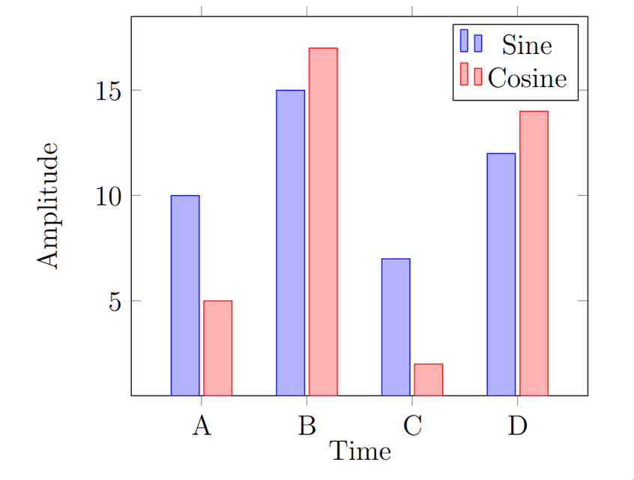
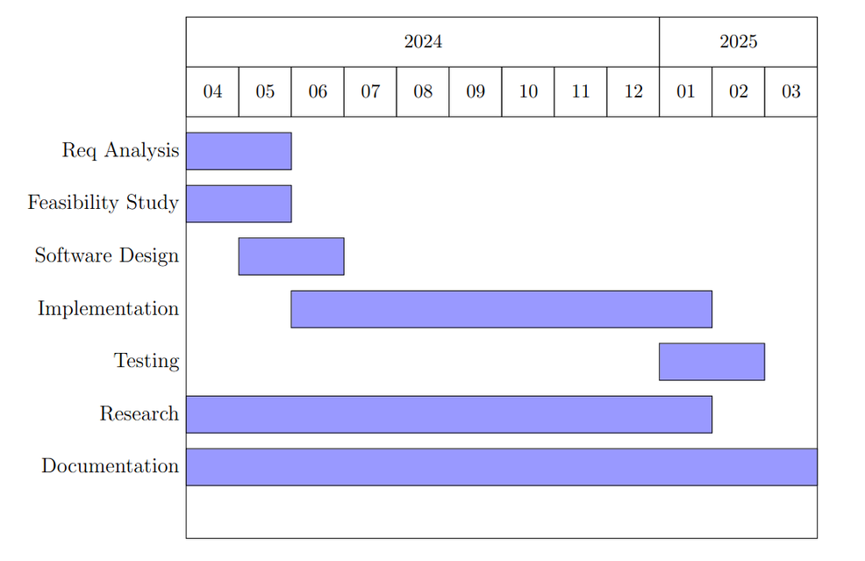
BAR CHART & GANTT CHART

Slide 27
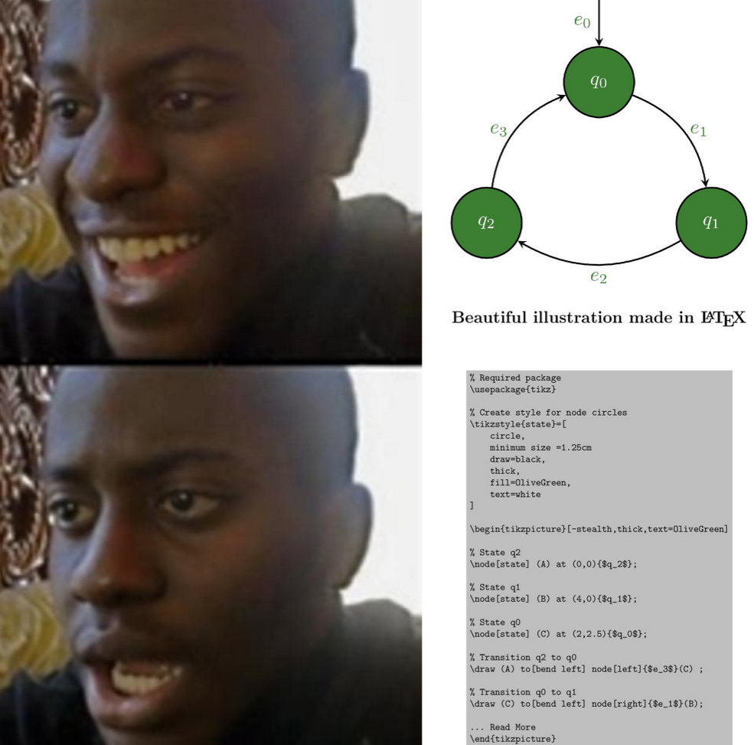

Slide 28
CITATION AND BIBILOGRAPHY

Slide 29

CITATION AND BIBILOGRAPHY
@book{aReference,
author = {Donald E. Knuth},
year = {1986},
title = {The {\TeX} Book},
publisher = {Addison-Wesley Professional}
}
@book{bReference,
author = {Frank Mittelbach and Michel Gossens
and Johannes Braams and David Carlisle
and Chris Rowley},
year = {2004},
title = {The {\LaTeX} Companion},
publisher = {Addison-Wesley Professional},
edition = {2}
}
@book{cReference,
author = {Leslie Lamport},
year = {1994},
title = {{\LaTeX}: a Document Preparation System},
publisher = {Addison Wesley},
address = {Massachusetts},
edition = {2}
}

Slide 30





CITATION AND BIBILOGRAPHY
Almost all sites provide citation links!

Slide 31
CITATION AND BIBILOGRAPHY
Commands:
Change reference order
\bibliographystyle { }
Cite a sentence
\cite { }
Generate Bibilography page
\bibliography { }

Slide 32
SPECIAL COMMANDS
\tableofcontents
\listoffigures
\listoftables
\addcontentsline{toc}{section}{Unnumbered Section}
lof
lot

Slide 33



THANK
YOU

